Slide 1
Magnetism

Slide 2
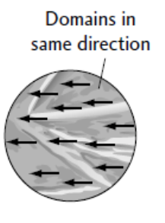
Domain Theory of Magnets
Magnets are made of iron, nickel, or cobalt.
All large magnets are made up of many smaller and rotatable magnets, called dipoles, which can interact with other dipoles close by.
If dipoles line up, then a small magnetic domain is produced.

Slide 3
Magnetic Force
Put a bar magnet on a piece of paper and carefully sprinkle iron powder around the bar magnet. It shows the magnetic field lines around the magnet.
A compass can be used to map the direction of the magnetic field lines around a magnet. The compass needle will align itself along the direction of the field.

Slide 4
A magnetic field is the three-dimensional region of space surrounding a magnet that will exert a force on magnetic objects.
They always point from N to S outside a magnet and S to N inside (they form a closed loop)
never cross one another, and are closer together where the magnetic field is stronger (poles).

Slide 5
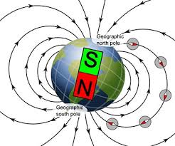
Earth is a big Magnet
Earth has a magnetic field that exists both inside and surrounding it.
Earth’s magnetic north pole is existing with the south geographic pole.
Earth’s magnetic south pole is existing with the geographic north pole.

Slide 6
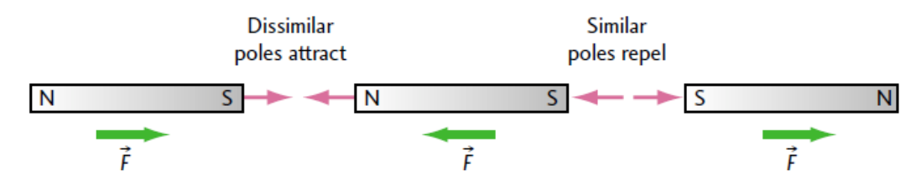
Law of Magnetic Poles
Similar magnetic poles repel.

Slide 7
Law of Magnetic Poles
Dissimilar magnetic poles attract.

Slide 8
Electromagnets

Slide 9
Electric Current
Oersted’s Principle: A Charge moving through a conductor produces a circular magnetic field around the conductor.
How can Electric current creates a magnet

Slide 10
Right Hand Rule # 1:
if a straight conductor is held in your right hand with your right thumb pointing in the direction of the current, your curled fingers will point in the direction of the magnetic field lines surrounding the conductor.

Slide 11
Representing Currents & Magnetic Fields
The X represents current in a conductor moving into the page, and the blue concentric circles show the direction of the magnetic field.
The dot represents current in a conductor moving out of the page, and the blue concentric circles show the direction of the magnetic field.

Slide 12
Example:
Copy each diagram in the given figure into your notebook and draw the magnetic field.
Copy each diagram in the given figure into your notebook and label the direction of the conventional current
H W questions # 20, 21, on page 599 – 600 of the package and
Questions # 1 – 7 on page 552 and # 1 – 7 on page 556 of the textbook

Slide 13
Magnetic Field of a Loop
The magnetic field around a straight conductor can be intensified by bending the wire into a loop.
Note that in the centre of the loop, the magnetic field points straight through.
The positive and negative signs denote the direction of the conventional current from positive to negative.

Slide 14
Magnetic Field of a Solenoid
A large number of loops wound close together to form a coil, or solenoid.
The overall magnetic field is similar to the magnetic field of a bar magnet.
The magnetic field is strongest at the poles or ends of the coils and is weakest at the sides.

Slide 15
Right Hand Rule # 2
The fingers of your right hand wrap around the coil in the direction of the conventional current, while your right thumb points in the direction of the north magnetic pole of the coil.

Slide 16
Example:
The following diagram shows coils
of wire wound on cardboard cylinders. Copy the diagrams into your notebook, and on each diagram mark the N-pole and S-pole of the coil.
(b)
(c)

Slide 17
Applications of solenoids
The subwoofer cone is made from paper that quickly vibrates.
A permanent circular magnet surrounds a solenoid called the voice coil.
The current in the voice cone produces a magnetic field that repels or attracts the voice coil with the cone away or to the magnet

Slide 18
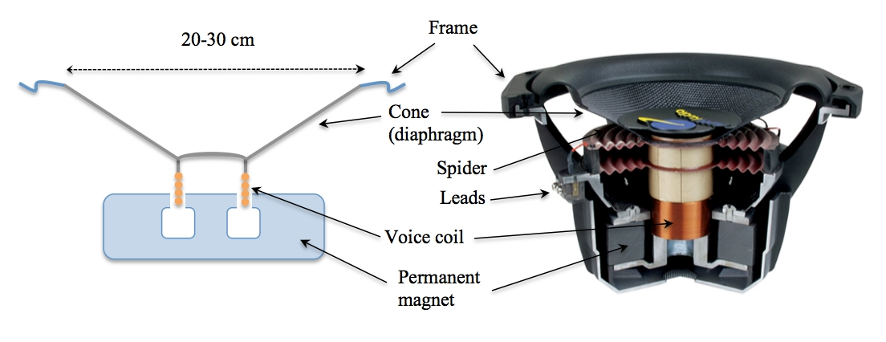
The current is reversed in direction to produce a magnetic field that attracts the voice coil and the cone towards the magnet.
This process repeats continually, producing compressions and rarefactions to create sound.

Slide 19
Solenoids in Electric bells
When the switch is closed, an electric current flows and the soft iron cores
become magnetized.
The cores attract the iron armature, which moves toward the electromagnet, causing the hammer to strike the bell.
As the hammer strikes the bell, the movement of the armature opens the contacts and the circuit is broken.

Slide 20
Solenoids in Lifting Electromagnet
Closing a switch causes an electric current in the coil, and the soft iron core becomes a very strong induced magnet.
Large steel plates, girders, and pieces of scrap iron can be lifted and transported by a lifting electromagnet.

Slide 21
The Motor Principle
The motor principle involves a force produced on conductors
when two magnetic fields interact, as shown in the given figure.

Slide 22
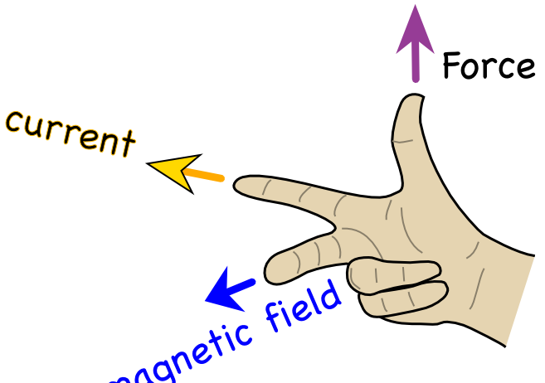
Right Hand Rule # 3
Electric Current
Magnetic Field
The thumb and forefinger are in a plane with the palm, at right angles to one another, and the middle finger is perpendicular to that plane.
Magnetic
Force
Point your thumb in the direction of the current.
point your index finger in the direction of the magnetic field.
Then your middle finger is pointing in the direction of the magnetic force.

Slide 23
Example:
Copy each diagram in the given Figure into your notebook, and draw the magnetic field lines of both the magnet and the conductor. Then determine the direction of the force on the conductor.

Slide 24
Example:
For the diagrams in the given figure, use the third right-hand rule for the motor principle to show the unknown direction of the specified quantity.
H W questions # 22, 23, 24, 25, 26, 27, 29 on page 600 – 602 of the package,
Questions # 1 – 7 on page 562, and # 1 – 6 on page 566 of the textbook

Slide 25
Electromagnetic Induction
Any change in the magnetic field strength near a conductor induces an electric current in the conductor which induces an electric current in the conductor.
Electromagnetic Induction

Slide 26
Electromagnetic Induction Factors:
Factors that affect the magnitude of induced current:
The number of turns of the induction coil
The rate of change of the inducing magnetic field (speed of motion)
The strength of the inducing magnetic field.

Slide 27
Electromagnetic Induction Factors:
Factors that affect the direction of induced current:
The direction of rotation of the coil (clockwise/ counter – clockwise ).
The direction of coil / magnet motion (moving away / towards).
The type of the magnetic pole(north / south) that is moving.

Slide 28
Lenz’s Law: If a changing magnetic field induces a current in a coil, the electric current is in such a direction that its own magnetic field opposes the change that produced it.
In figure (a), a south magnet must be induced at the end of the coil. The RHR#2 predicts that the direction of the
current flow in the coil.
In figure (b), a north magnet must be induced at the end of the coil. The RHR#2 for solenoids predicts that the direction
Of the current flow in the coil.

Slide 29
Example:
Using Right Hand Rule #2 for solenoids,
predict the direction of the induced current flow by adding arrows to your diagrams. Add an N or S to represent the magnetic poles at each end of the coil.
predict the polarity of the magnet that is being inserted or removed from the coils
H W Questions # 16, 17, 18, 19, 20 on page 625 – 627 of the package

Slide 30
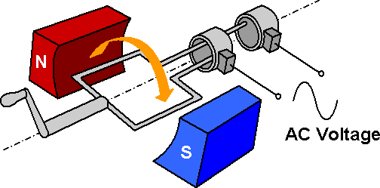
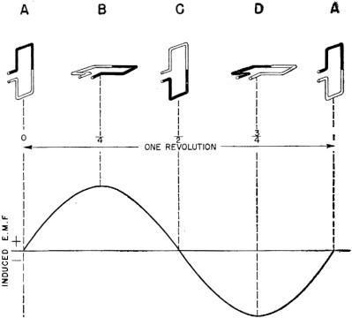
AC Generator
According to the Faraday's law of electromagnetic induction, whenever a conductor moves in a magnetic field EMF gets induced across the conductor.
If the close path is provided to the conductor, induced EMF causes Alternating current to flow in the circuit.
AC Generator

Slide 31
DC Generator
A split ring commutator is split so that the circuit is incomplete when the
loop is aligned with the split.
The split ring commutator and the wire loop (which are connected) are free to rotate around an axis.
The brushes are made out of conducting bristles. They make contact with the split ring commutator but still allow rotation.

Slide 32
The Armature DC Motor
The electric current flows in through the bottom brush, into split ring B, and through the coil, eventually entering split ring A and leaving the motor through the top brush. Using the right-hand rule for a coil, end A of the armature becomes a N-pole and is repelled by the N-pole of the external magnet, causing it to move away and rotate clockwise.

Slide 33
The Armature DC Motor
The top brush is now in contact with split ring B. Electric current continues to flow in through the bottom brush up through the coils, leaving by split ring B and the top brush. End A of the armature now becomes a S-pole and is repelled by the S-pole of the external magnet, causing the clockwise motion to continue.
(b)

Slide 34
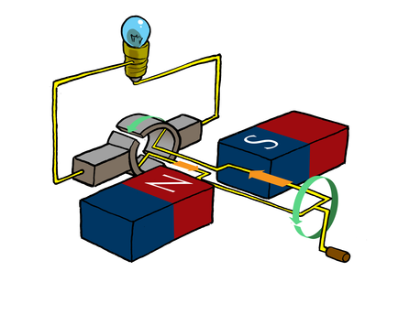
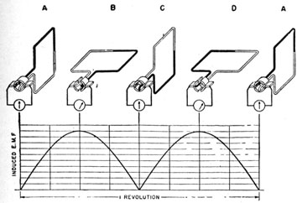
According to the Faraday's law of electromagnetic induction, whenever a conductor moves in a magnetic field EMF gets induced across the conductor.
If the close path is provided to the conductor, induced EMF causes Alternating current to flow in the circuit.
DC Generator
How DC Motor Works.mp4

Slide 35
Further Improvements in Motor Design:
To overcome these issues, DC motor
designers put several coils into the motors
and use a split ring commutator with
several splits. This means that:
the speed of the motor does not fluctuate as much a segment of the multiple split ring commutator is always in contact with the external circuit.

Slide 36
Transformers
Transformer: is an electromagnetic device that can raise or lower voltage.
The simple transformer, shown in Figure transforms current and voltage in a circuit. The primary side uses an alternating current to produce an electromagnet. The changing magnetic field in the secondary produces a
new alternating current.

Slide 37
Step-down transformer:
a transformer with fewer secondary windings than primary windings.
decreases the voltage in the secondary coil.
Step-up transformer:
a transformer with more secondary windings than primary windings.
increases the voltage in the secondary coil.

Slide 38
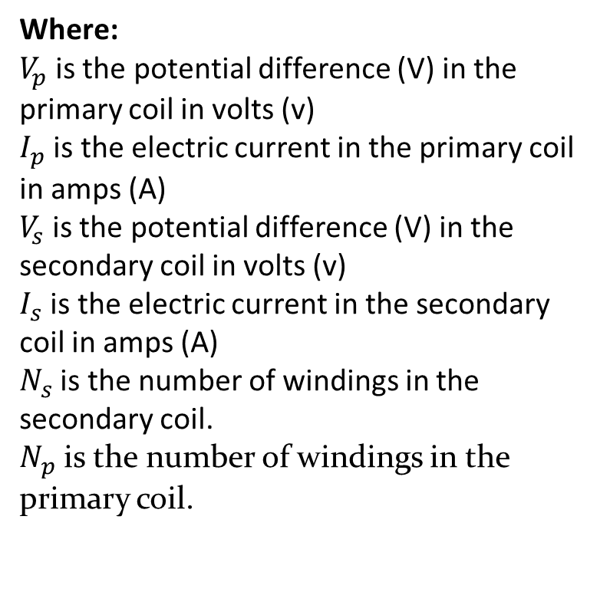
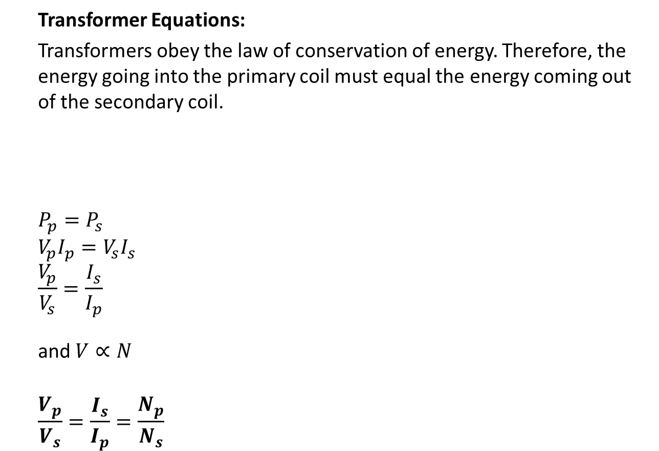
Transformer Equations:
Transformers obey the law of conservation of energy. Therefore, the energy going into the primary coil must equal the energy coming out of the secondary coil.
$$P_{p}=P_{s}$$
$$V_{p}I_{p}=V_{s}I_{s}$$
$$\frac{V_{p}}{V_{s}}=\frac{I_{s}}{I_{p}}$$
and $V∝N$
$$\frac{V_{p}}{V_{s}}=\frac{I_{s}}{I_{p}}=\frac{N_{p}}{N_{s}}$$
Where:
$V_{p}$is the potential difference (V) in the primary coil in volts (v)
$I_{p}$ is the electric current in the primary coil in amps (A)
$V_{s}$is the potential difference (V) in the secondary coil in volts (v)
$I_{s}$ is the electric current in the secondary coil in amps (A)
$N_{s}$ is the number of windings in the secondary coil.
$N_{p}$ is the number of windings in the primary coil.

Slide 39
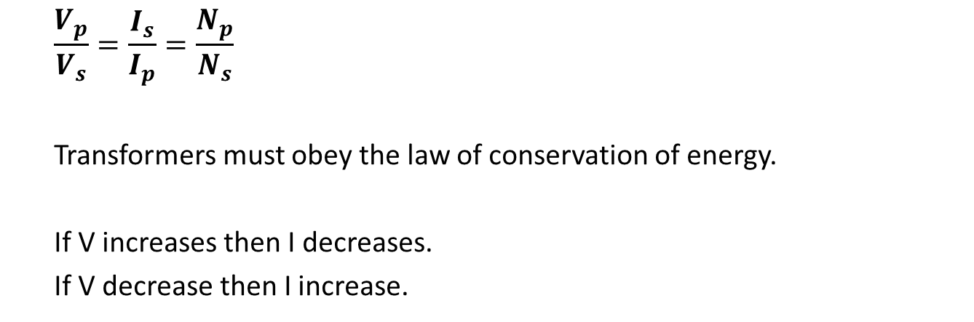
$$\frac{V_{p}}{V_{s}}=\frac{I_{s}}{I_{p}}=\frac{N_{p}}{N_{s}}$$
Transformers must obey the law of conservation of energy.
If V increases then I decreases.
If V decrease then I increase.

Slide 40
Example:
A door chime designed to operate at 8.0 V is connected to a 120 V power supply through a transformer. The number of windings of the secondary coil is 100 and the current in it is 1.8 A.
What is the number of windings in the primary coil?
What is the current in the primary coil?
What is the power rating of the chime?
What is the resistance of the chime?

Slide 41
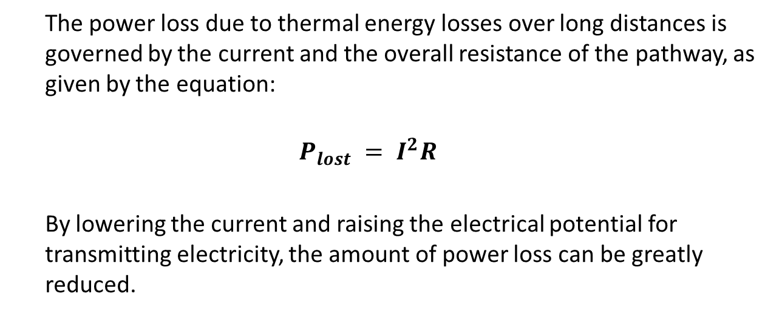
Transmitting Electrical Energy
The power loss due to thermal energy losses over long distances is governed by the current and the overall resistance of the pathway, as given by the equation:
$$P_{lost} = I^{2}R$$
By lowering the current and raising the electrical potential for transmitting electricity, the amount of power loss can be greatly reduced.

Slide 42
In the figure , the generator produces 20 kV of AC.

Slide 43
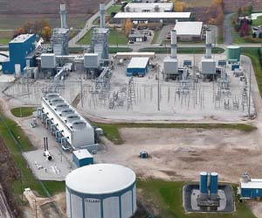
The generated 20 kV current of AC, is increased to higher 230 kV by transformers close to the generators to minimize energy loss.

Slide 44
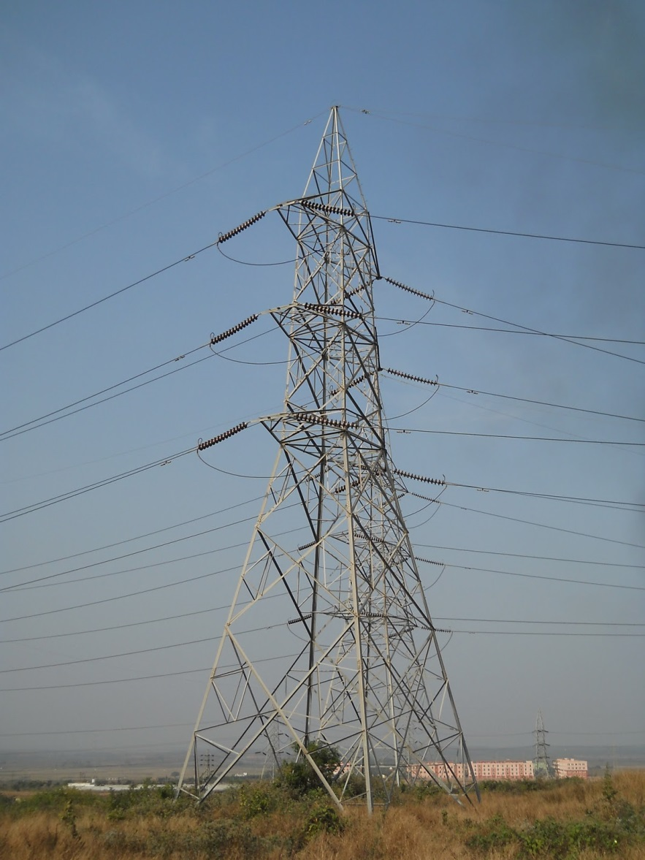
The electricity is then sent along power transmission lines suspended high above the ground supported by towers.
The electric transmission towers are carrying 230 kv current.

Slide 45
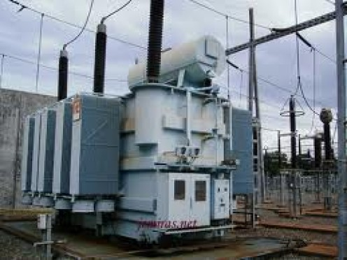
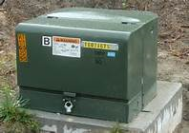
The electricity is gradually decreased in voltage at a district transformer from 230 kv to
station, a local transformer station, a substation, and then a pole or ground transformer in your neighbourhood.

Slide 46
Example:
Compare the power lost in transmission for a 1000 W line at 100 V to the
same power on a line at 1000 V. In both cases, the resistance of the line
is 1 Ω.

